Slide 1
Angular End User with Java Back End

Slide 2
Implement HTTP Client
for the Angular End-User Project
Notes:
Let us now make the front end communicate with the back end using http client in Angular.
Now, we will proceed with Angular End User Project which involves login flow, browsing products, placing orders, wish listing products and managing the shopping cart

Slide 3





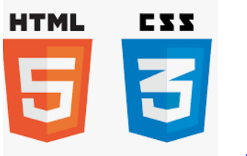

Before we begin, let’s recall what we have covered till now:
Agile
Git
SQL
Angular
HTML
CSS
JavaScript
CoreJava

Slide 4





Before we begin, let’s recall what we have covered till now:
JDBC
JSP
Servlets
MongoDB
Maven

Slide 5





Before we begin, let’s recall what we have covered till now:
JUnit
Spring
Spring Boot
Webservices
MicroServices

Slide 6
Create Angular Apps
Developed the front end using Angular
Created admin and end-user projects
Created Spring Boot Java Back End
Created and set up a spring boot project
Configured dependencies for web and DB
Configured Server and DB Details
Configured Apache Tomcat server
Configured database properties in the Java back-end project
Create Microservices
Created microservices in the Java back-end project
Connected with MySQL database

Slide 7
As a full stack web developer, our key role is to develop both client and server software.
Angular and Node can be used to build the front end of the web page.
Spring Boot, Java, and MySQL or MongoDB can be used to build at the back end.

Slide 8

Now, Bob needs to develop Angular Admin with Java Backend. So, Bob brainstorms a bit and finds a solution.
Let me use my skills in JavaScript, Angular, Spring, Spring Boot, Web Services, and Microservices and make the front end communicate with the backend.
In this lesson, we will use HttpClientModule in our Angular project, send the Request to the Services in the backend, process the response, and help Bob complete his task effectively and quickly.

Slide 9

Build the front-end and back-end communication for the Angular end user
Implement the HTTP request and response flow
Use HttpClientModule in Angular
Validate the login flow and database with data

Slide 10
Implement HttpClient in Angular Components
Notes:
Let us now, implement HttpClient API in Angular to perform request response over HTTP to various back-end services.

Slide 11
Add the HTTPClientModule in app.module.ts
In the app.module.ts, add the HttpClientModule from angular common http.
import { HttpClientModule } from '@angular/common/http';
@NgModule({
declarations: [
AppComponent,
//… ],
imports: [
BrowserModule,
BrowserAnimationsModule,
AppRoutingModule,
NgbModule,
HttpClientModule, ],
bootstrap: [AppComponent]
})
export class AppModule { }
Notes:
In the app.module.ts, add the HttpClientModule from angular common http.

Slide 12
Define the Endpoints for the Services in the Back End
Users create a new class base URLs where the user can define all the endpoints
for the various services in the back end
localhost:8080 is where the Java back end will be running and hence the base URL is defined with the value http://localhost:8080.
The user may use the port number per the application.properties
server port in the Java back end.
To make the application go live, change this base URL per production server requirements where the Java back end is hosted
and running.
Notes:
Create a new class Base URLs where we can define all the the endpoints for the various services in the back end.
localhost:8080 is where our java back end will be running and hence the base URL is defined with value http://localhost:8080. You may use the port number as per the application.properties server port in your java back end. To make the application go live, we must change this base URL as per our production server details where java back end is hosted and running.

Slide 13
Define the Endpoints for the Services in the Back End
In the Back End, define the Endpoints for the Services:
export class BaseUrls {
public static readonly BASE_HREF: string = "http://localhost:8080";
public static readonly USER_GROUPURL: string = "users";
public static readonly SHIPMENT_GROUPURL: string = "shipments";
public static readonly PRODUCT_GROUPURL: string = "products";
public static readonly ORDER_GROUPURL: string = "orders";
public static readonly ORDER_ITEMS_GROUPURL: string = "orderitems";
public static readonly CATEGORIES_GROUPURL: string = "categories";
public static readonly CART_GROUPURL: string = "cart";
public static readonly WISHLIST_GROUPURL: string = "wishlist";

Slide 14
Define the Endpoints for the Services in the Back End
In the Back End, define the Endpoints for the Services:
public static getUrl(key: string): string { return `${this.BASE_HREF}/${key}/get`;}
public static getAddUrl(key: string): string { return `${this.BASE_HREF}/${key}/add`;}
public static getUpdateUrl(key: string): string { return `${this.BASE_HREF}/${key}/update`;}
public static getDeleteUrl(key: string): string { return `${this.BASE_HREF}/${key}/delete`;}
public static getLoginUrl(key: string): string { return `${this.BASE_HREF}/${key}/login`;}
}

Slide 15
AuthService
Create an authservice that will have definitions for loginUser and registerUser methods.
Methods use the HttpClient to request the Java back-end service
to perform authentication.
Notes:
For the end-user web app authentication, we will create an authservice which will have definitions for loginUser and registerUser methods.
Methods uses HttpClient to request the Java back-end service to perform authentication.

Slide 16
AuthService
Here, users can see how the loginUser method makes the http request to the Java back end to check the user details from the database.
loginUser(value: {email: string; password: string}) {
const formData = new FormData();
formData.append("email", value.email.trim() || "");
formData.append("password", value.password.trim() || "");
this.http.post(BaseUrls.getLoginUrl(BaseUrls.USER_GROUPURL), formData)
.subscribe({
next: ({ code, message, data }: any) => {
localStorage.setItem("user", JSON.stringify(data[0]));
this.toast.success(message, "Login Successfull");
this.router.navigate(['/'], { replaceUrl: true })
},
error: (error) => {
localStorage.setItem("user", JSON.stringify(null));
this.toast.warning("Please Check Your Credentials", "");
}})}
Notes:
Here you can see how loginUser method makes the http request to the Java back end to check the user details from the database.

Slide 17
Login Component for End-User Login
For the end-user web app authentication, create a login component which reads the form data entered by the end-user in the login form.
The login component uses AuthService, where the authentication
is done using the loginUser method.
Notes:
For the end-user web app authentication, create a login component which reads the form data entered by the end-user in the login form.
The login component uses AuthService, where the authentication is done using the loginUser method.

Slide 18
Login Component for End-User Login
For end-user login use a login component.
export class LoginComponent implements OnInit {
errorMsg: string | undefined;
loginInProcess: boolean = false;
loginForm: FormGroup = new FormGroup({
email: new FormControl(null, [Validators.required, Validators.email]),
password: new FormControl(null, [Validators.required]) })
constructor(
private authService: AuthService,
private toast: ToastrService ) { }
loginUser = () => {
if(this.loginForm.invalid) {
this.toast.info("All Field Required", "");
return; }
this.authService.loginUser(this.loginForm.value); }}

Slide 19
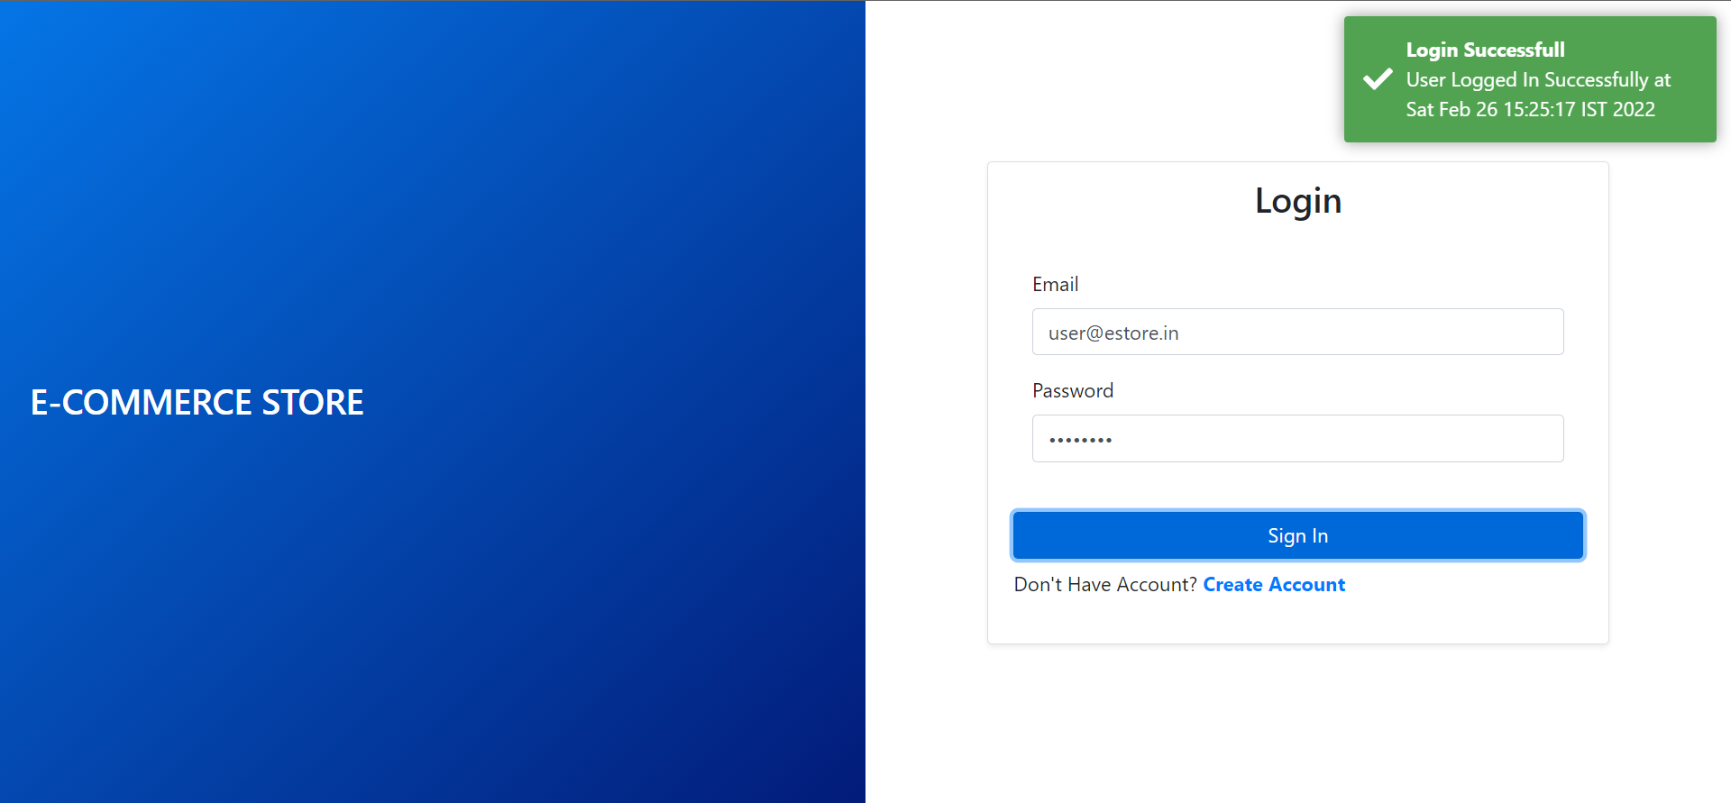
Login Component for End-User Login: Success
Once the API sends a response for success, it will show a toast message to the end user.
Notes:
Once the API sends a response for success, it will show a toast message to the end user.

Slide 20
AuthService: Register for End User
Here, users can see how the registerUser method makes the HTTP request to the Java back end to save the details of the user in the database.
registerUser(values: any) {
const formData: FormData = new FormData();
Object.entries(values).forEach(([key, value]: [string, any], idx: number) => {
formData.append(key, value); });
this.http.post(BaseUrls.getAddUrl(BaseUrls.USER_GROUPURL), formData)
.subscribe({
next: ({ code, message, data }: any) => {
localStorage.setItem("user", JSON.stringify(data[0]));
// this.router.navigate(['/'], { replaceUrl: true })
setTimeout(() => this.router.navigate(['/'], { replaceUrl: true }), 2000)
this.toast.success("", "Registered Successfull"); },
error: (error) => {
console.log(error);
localStorage.setItem("user", JSON.stringify(null));
this.toast.warning("Something Went Wrong!! Please Again...", "Failed");
}})}
Notes:
Here you can see how registerUser method makes the HTTP request to the Java back end
to save the details of the user in the database.

Slide 21
Register Component for End-User Registration
1
Create a register component that takes the form data entered
by the end user in a register form.
2
The register component uses AuthService, where the registration of the user is done using the registerUser method.
3
The method will make Http request to the Java back end to save user details.
Notes:
For end-user registration on web app, we will create a Register Component which takes the form data entered by the end user in a register form.
The Register component uses AuthService, where the registration of the user is done using the registerUser method.
The method will make Http Request to Java back end to save user details

Slide 22
Register Component for End-User Registration
For End-User Registration, use the Register Component.
export class RegisterComponent implements OnInit {
errorMsg: string | undefined;
loginInProcess: boolean = false;
registerForm: FormGroup = new FormGroup({
email: new FormControl(null, [Validators.required, Validators.email]),
password: new FormControl(null, [Validators.required, Validators.minLength(6)]),
fullName: new FormControl(null, Validators.required),
street: new FormControl(null),
city: new FormControl(null),
state: new FormControl(null),
country: new FormControl(null),
pincode: new FormControl(0),
image: new FormControl(null),
contact: new FormControl(0), });
constructor(
private toast: ToastrService,
private authService: AuthService ) { }
registerUser() {
if(this.registerForm.invalid) {
this.toast.info("", "All Fields are required");
return; }
this.authService.registerUser(this.registerForm.value); }}

Slide 23
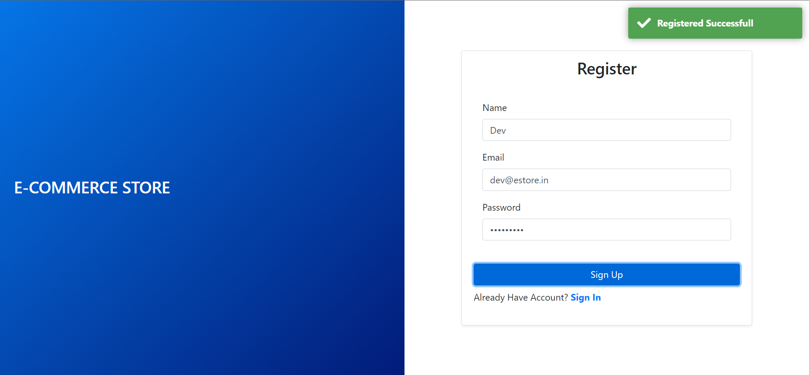
Register Component for End-User Registration: Success
Once the API sends response for success, show a toast message to the end user when the registration is completed.
Notes:
Once the API sends response for success, we will show a toast message to the end user when the registration is completed.

Slide 24
User Profile Component for End User
Create a user profile component that takes the form of data entered
by the end user in the profile form.
UpdateProfile method makes a HTTP request to the Java back end
to update the details of the user in the database.
Notes:
For the end-user profile on Web App, we will create a user profile component which takes the form data entered by the end user in
the profile from.
UpdateProfile method will make a HTTP request to the Java back end to update the details of the user in the database.

Slide 25
User Profile Component for End User
For End-Users, use the User Profile Component.
export class UserProfileComponent implements OnInit {
//…
updateProfile() {
this.loader = true;
let formData: FormData = new FormData();
Object.entries(this.userForm.value).forEach(([key, value]: [string, any], idx: number) => {
formData.append(key, value);
});
this.httpClient.post(BaseUrls.getUpdateUrl(BaseUrls.USER_GROUPURL), formData)
.subscribe({
next: ({ code, message, data }: any) => {
this.loader = false;
localStorage.setItem("user", JSON.stringify(data[0]));
this.toast.success("Profile Updated", "Success")
},
error: (error) => {
// console.log(error);
this.toast.warning("Something Went Wrong!! Please Again...", "Failed");
this.loader = false;
}, }) } }

Slide 26
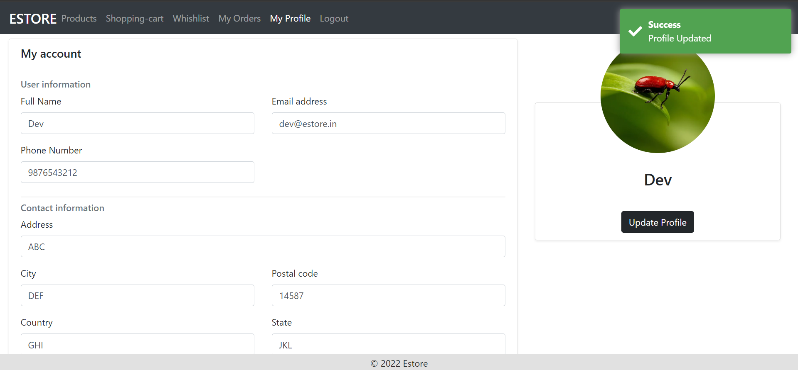
User Profile Component for End User: Success
Once the API sends response for success, show a toast message to the end user when the profile is updated in the database.
Notes:
Once the API sends response for success, we will show a toast message to the end user when the profile is updated in database.

Slide 27
DB Service
The end-user Angular project is similar to the admin project.
A DBService requests the Java back end to fetch data for various modules in our project.
export class DbService {
//…
constructor(
private httpClient: HttpClient
) { }
getUsers(){
//…
}
getProducts(){
//…
}
//…
}
Notes:
The end-user Angular project is similar to the admin project.
We will have a DBService which requests the Java back end to fetch data for various modules in our project

Slide 28
DB Service: getProducts
The DB Service getProducts method performs HTTP Client request
to the product service endpoint in the Java back end to fetch all products.
export class DbService {
//…
constructor(
private httpClient: HttpClient
) { }
//…
getProducts() {
if (!this.productsRetreived) {
this.http.get(BaseUrls.getUrl(BaseUrls.PRODUCT_GROUPURL))
.subscribe({
next: ({ code, message, data }: any) => {
this.productsSub.next(Object.assign([], data))
this.productsRetreived = true
},
error: (error) => {
console.log(error);
}})} }}
Notes:
The DB Service getProducts method performs HTTP Client request to product service endpoint in the Java back end to fetch all products.

Slide 29
getProducts and getCategories Using DBService
The Products component uses the DB Service getProducts and getCategories method
to display all the products along with categories to the end-user web app.
The user can filter the products from the UI based on various filters.
Notes:
Products Component shall use the DB Service getProducts and getCategories method to display all the products alongwith categories to the end user web app.
The user can filter the products from the UI based on various filters.

Slide 30
getProducts and getCategories Using DBService
export class ProductsComponent implements OnInit { //..
constructor(
private httpClient: HttpClient,
public db: DbService,
private toast: ToastrService ) { }
ngOnInit(): void {
this.fetching = true;
this.db.getProducts();
this.db.getCategoeies();
combineLatest([this.db.productsSub, this.db.categoriessSub])
.subscribe({
next: ([products, categories]) => {
this.fetching = false
if(products.length !== 0) {
this.products = products;
this.tempProducts = products; }
if(categories.length !== 0) {
this.categories = categories;
this.categories.splice(0, 0, { categoryId: "", categoryName: "All" });}},
error: (error) => {
this.fetching = false; } })}}

Slide 31
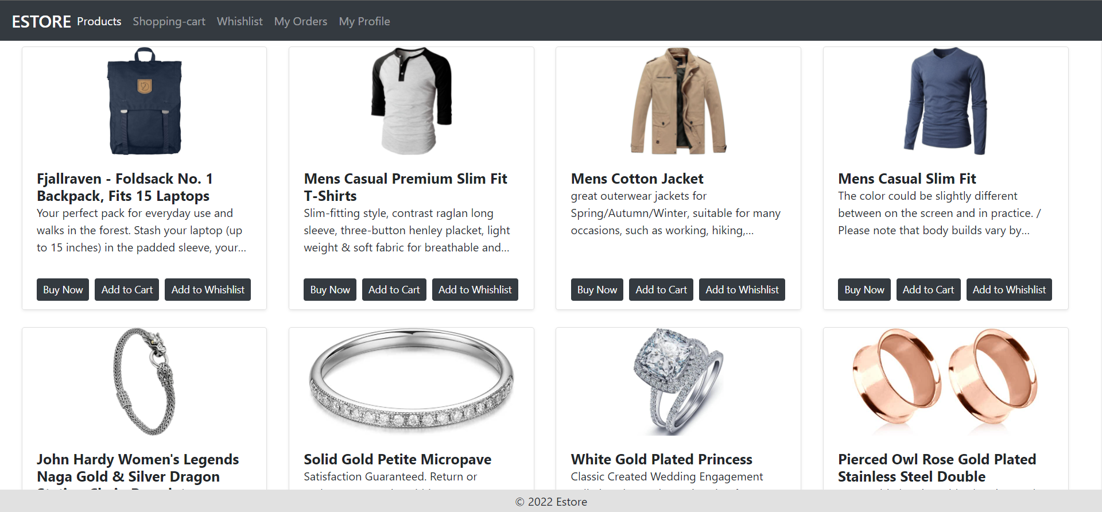
Products Component: Listing Products on the UI
The component displays the list of products on the UI using DB Service getProducts method, which makes the Java back-end HTTP request internally.
Notes:
The component displays the list of products on the UI using DB Service getProducts method, which makes the Java back end HTTP request internally.

Slide 32
Products Component: Listing Products on the UI
Snippet for HTML template of the component:
ng-container *ngIf="products.length !== 0">
<div class="col-12 col-sm-6 col-md-4 col-lg-3 mb-4" *ngFor="let product of products">
<div class="card shadow-sm" style="height: 100%;">
<img [src]="product['images'][product['thumbnailImage']]" alt="" class="card-img-top img" *ngIf="product.images.length !== 0">
<div class="card-body">
<h5 class="m-0 font-weight-bold card-title">
{{ product["productTitle"] }}
</h5>
<h6 class="m-0 font-weight-bold card-subtitle text-muted">
{{ product["productCode"] }}
</h6>
<p class="card-text text-limit mt-2">
{{ product["productDescription"] }}
</p>
</div>
Notes:
Snippet for HTML template of the component:
ng-container *ngIf="products.length !== 0">
<div class="col-12 col-sm-6 col-md-4 col-lg-3 mb-4" *ngFor="let product of products">
<div class="card shadow-sm" style="height: 100%;">
<img [src]="product['images'][product['thumbnailImage']]" alt="" class="card-img-top img" *ngIf="product.images.length !== 0">
<div class="card-body">
<h5 class="m-0 font-weight-bold card-title">
{{ product["productTitle"] }}
</h5>
<h6 class="m-0 font-weight-bold card-subtitle text-muted">
{{ product["productCode"] }}
</h6>
<p class="card-text text-limit mt-2">
{{ product["productDescription"] }}
</p>
</div>
<div class="card-footer bg-white border-0">
<div class="d-flex justify-content-evenly align-items-center">
<button type="button" class="btn btn-sm btn-dark mr-2">
Buy Now
</button>
<button type="button" class="btn btn-sm btn-dark mr-2" (click)="db.addProductToList(product['productId'], true)">
Add to Cart
</button>
<button type="button" class="btn btn-sm btn-dark" (click)="db.addProductToList(product['productId'], false)">
Add to Whishlist
</button>
</div>
</div>
</div>
</div>
</ng-container>

Slide 33
Products Component: Listing Products on the UI
Adding Products to the User Interface.
<div class="card-footer bg-white border-0">
<div class="d-flex justify-content-evenly align-items-center">
<button type="button" class="btn btn-sm btn-dark mr-2">
Buy Now
</button>
<button type="button" class="btn btn-sm btn-dark mr-2" (click)="db.addProductToList(product['productId'], true)">
Add to Cart
</button>
<button type="button" class="btn btn-sm btn-dark" (click)="db.addProductToList(product['productId'], false)">
Add to Whishlist
</button>
</div>
</div>
</div>
</div>
</ng-container>
Notes:
Snippet for HTML template of the component:
ng-container *ngIf="products.length !== 0">
<div class="col-12 col-sm-6 col-md-4 col-lg-3 mb-4" *ngFor="let product of products">
<div class="card shadow-sm" style="height: 100%;">
<img [src]="product['images'][product['thumbnailImage']]" alt="" class="card-img-top img" *ngIf="product.images.length !== 0">
<div class="card-body">
<h5 class="m-0 font-weight-bold card-title">
{{ product["productTitle"] }}
</h5>
<h6 class="m-0 font-weight-bold card-subtitle text-muted">
{{ product["productCode"] }}
</h6>
<p class="card-text text-limit mt-2">
{{ product["productDescription"] }}
</p>
</div>
<div class="card-footer bg-white border-0">
<div class="d-flex justify-content-evenly align-items-center">
<button type="button" class="btn btn-sm btn-dark mr-2">
Buy Now
</button>
<button type="button" class="btn btn-sm btn-dark mr-2" (click)="db.addProductToList(product['productId'], true)">
Add to Cart
</button>
<button type="button" class="btn btn-sm btn-dark" (click)="db.addProductToList(product['productId'], false)">
Add to Whishlist
</button>
</div>
</div>
</div>
</div>
</ng-container>

Slide 34
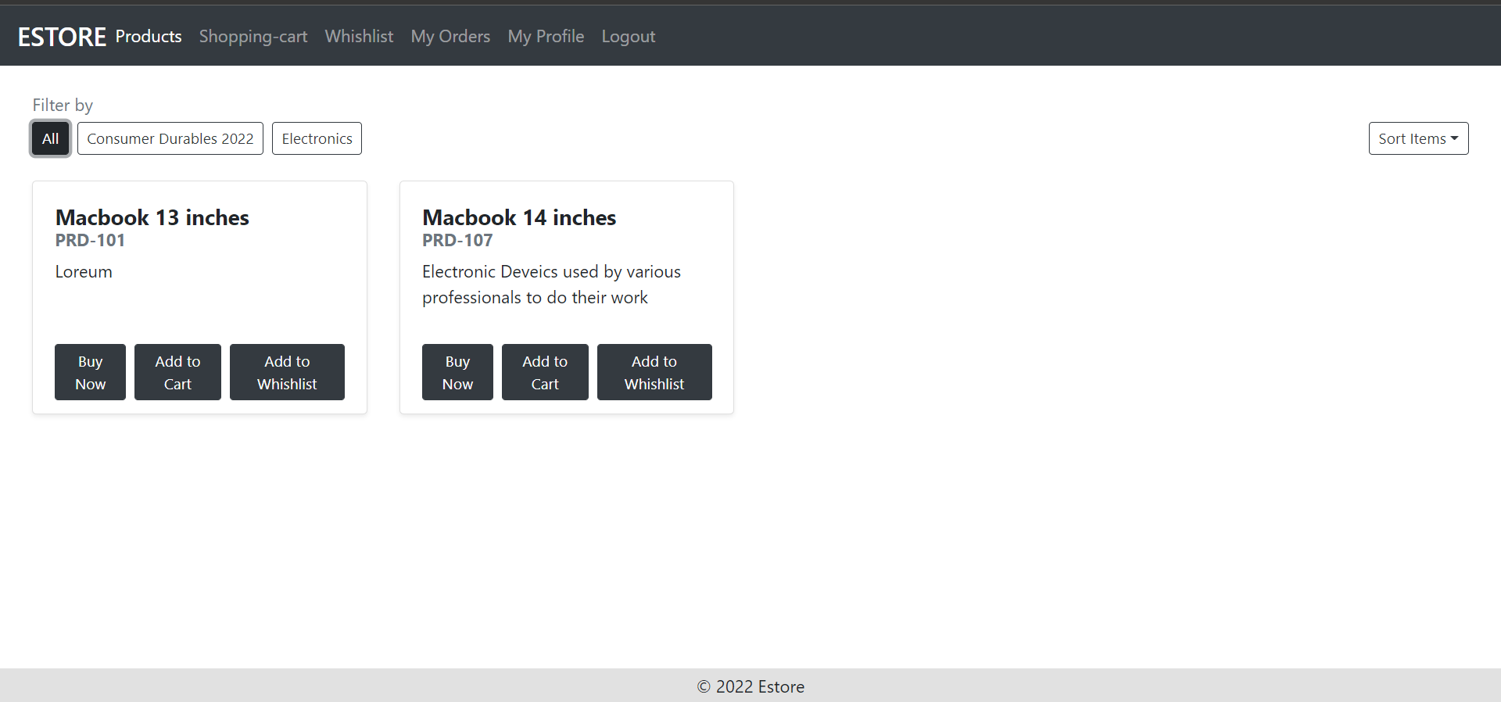
Products Categories: Listing Categories on the UI
The component displays the list of product categories on the UI using the DB Service getCategories method, which makes the Java back-end HTTP request internally.
Notes:
The component displays the list of product categories on the UI using the DB Service getCategories method, which makes the Java back-end HTTP request internally.

Slide 35
Products Categories: Listing Categories on the UI
Snippet for HTML template of the component:
<div class="d-flex align-items-center">
<button *ngFor="let category of categories; index as idx" class="btn btn-sm mb-2 mr-2" [ngClass]="{
'btn-dark': selectedCategoryIdx === idx,
'btn-outline-dark': selectedCategoryIdx !== idx
}"
(click)="filtersProductsBasedCategory(category.categoryId, idx)">
{{ category?.categoryName || "" }}
</button>
</div>
Notes:
Snippet for HTML template of the component:
<div class="d-flex align-items-center">
<button *ngFor="let category of categories; index as idx" class="btn btn-sm mb-2 mr-2" [ngClass]="{
'btn-dark': selectedCategoryIdx === idx,
'btn-outline-dark': selectedCategoryIdx !== idx
}" (click)="filtersProductsBasedCategory(category.categoryId, idx)">
{{ category?.categoryName || "" }}
</button>
</div>

Slide 36
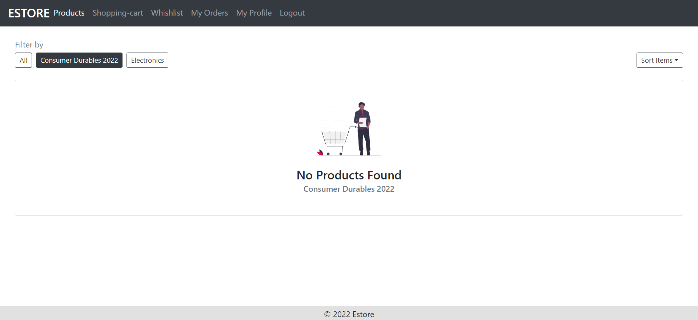
Products Categories: Filtering
The component displays the list of the product per the filters on the UI.
Notes:
The component displays the list of product as per the filters on the UI.

Slide 37
Products Categories: Filtering
Snippet for HTML template of the component:
<div class="d-flex flex-column justify-content-end align-items-end" style="height: 100%;">
<div ngbDropdown>
<button class="btn btn-sm btn-outline-dark mb-2" id="dropdownBasic1" ngbDropdownToggle>Sort Items</button>
<div ngbDropdownMenu aria-labelledby="dropdownBasic1">
<button ngbDropdownItem>By Price [Lowest to Highest]</button>
<button ngbDropdownItem>By Price [Highest to Lowest]</button>
<button ngbDropdownItem>By Rating</button>
</div>
</div>
</div>
Notes:
Snippet for HTML template of the component:
<div class="d-flex flex-column justify-content-end align-items-end" style="height: 100%;">
<div ngbDropdown>
<button class="btn btn-sm btn-outline-dark mb-2" id="dropdownBasic1" ngbDropdownToggle>Sort Items</button>
<div ngbDropdownMenu aria-labelledby="dropdownBasic1">
<button ngbDropdownItem>By Price [Lowest to Highest]</button>
<button ngbDropdownItem>By Price [Highest to Lowest]</button>
<button ngbDropdownItem>By Rating</button>
</div>
</div>
</div>

Slide 38
DB Service: getUserWishlist
The DB Service getUserWishlist method performs HTTP client request to the wishlist service endpoint in the Java back end to fetch all the products wishlisted
by the end user.
export class DbService { //…
constructor(private httpClient: HttpClient) { }
getUserWishlist(): void { this.http.get(`${BaseUrls.BASE_HREF}/${BaseUrls.WISHLIST_GROUPURL}/get-user-wishlist/${this.user?.userId}`)
.subscribe({
next: async ({ data }: any) => {
let response = Array.from(data);
let ids = response.map((e: any) => e['productId']).join(",")
if(ids.length !== 0) {
let prdList: any = await this.getParticularProductsBasedOnIds(ids);
let wishlist = response.map((wObj: any, idx: number) => {
let prd = prdList.find((x: any) => x.productId === wObj['productId']);
delete prd.productId;
return { ...wObj, ...prd }; });
this.wishlistsSub.next(wishlist); }},
error: (error) => this.toast.warning("Something Went Wrong!! Please Again...", "Failed") });}}
Notes:
The DB Service getUserWishlist method performs HTTP Client Request to Wishlist Service Endpoint in the Java back end to fetch all products wish listed by the end user

Slide 39
Wishlist Component: getUserWishlist
The Wishlist component uses the getUserWishlist method to display all the orders wish listed by users in the admin dashboard.
Since the order has a state which the admin can update, we will implement the methods in the same component for better management of the code.
Notes:
The Wishlist component uses the getUserWishlist method to display all the orders wish listed by users in the admin dashboard.
Since the order has a state which the admin can update, we will implement the methods in the same component for better management of the code.

Slide 40
Wishlist Component: getUserWishlist
The getUserWishlist method is used by the Wishlist component to display all the orders.
export class WhishlistComponent implements OnInit {
wishlists: any[] = [];
constructor(
public db: DbService,
private toast: ToastrService
) { }
ngOnInit(): void {
this.db.wishlistsSub.subscribe((list) => {
if(list.length !== 0) this.wishlists = list;
})
}
removeItem(id: any) {
this.db.removeItemFromList(id, false);
this.db.getUserWishlist();
this.db.wishlistsSub.next(this.wishlists.splice(this.wishlists.findIndex(x => x['wishListId'] === id), 1))
}
}

Slide 41
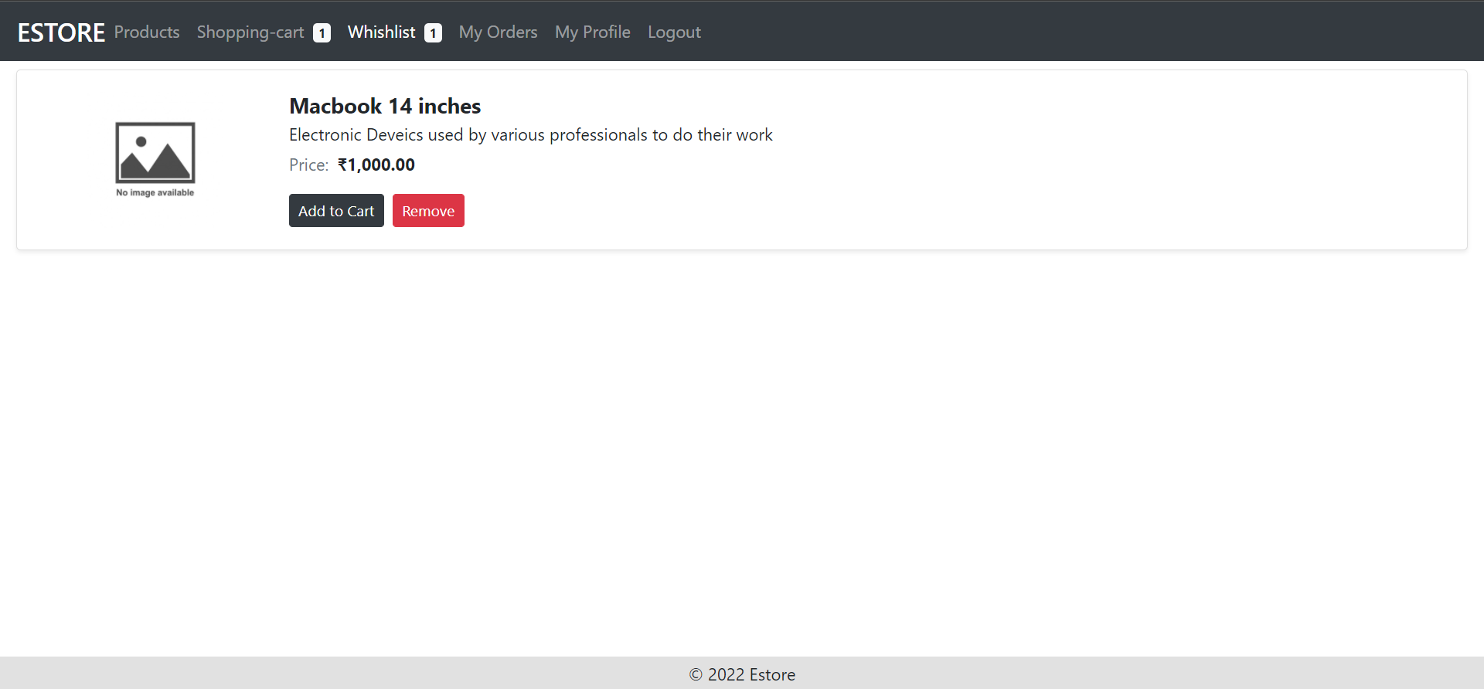
Wishlist Component: UI
The component displays the list of wishlist products on the UI.
Notes:
The component displays the list of wish listed products on the UI.

Slide 42
Wishlist Component: UI
Snippet for HTML template of the component:
<div *ngIf="wishlists.length !== 0">
<div class="card shadow-sm mb-2" *ngFor="let product of wishlists; index as idx">
<div class="card-body">
<div class="row w-100 m-0">
<div class="col-12 col-sm-2 d-flex justify-content-center align-items-center">
<img [src]="product['images'][product['thumbnailImage']] || './../../../assets/noImage.jpg'" [alt]="product['productTitle']" class="img-fluid" width="128px" height="128px">
</div>
<div class="col-12 col-sm-10 mt-2 mt-sm-0">
<div class="d-flex flex-column">
<h5 class="m-0 font-weight-bold card-title mb-1">
{{ product["productTitle"] }}
</h5>
<p class="card-text text-limit m-0 mb-1">
{{ product["productDescription"] }}
</p>
Notes:
Snippet for HTML template of the component:
<div *ngIf="wishlists.length !== 0">
<div class="card shadow-sm mb-2" *ngFor="let product of wishlists; index as idx">
<div class="card-body">
<div class="row w-100 m-0">
<div class="col-12 col-sm-2 d-flex justify-content-center align-items-center">
<img [src]="product['images'][product['thumbnailImage']] || './../../../assets/noImage.jpg'" [alt]="product['productTitle']" class="img-fluid" width="128px" height="128px">
</div>
<div class="col-12 col-sm-10 mt-2 mt-sm-0">
<div class="d-flex flex-column">
<h5 class="m-0 font-weight-bold card-title mb-1">
{{ product["productTitle"] }}
</h5>
<p class="card-text text-limit m-0 mb-1">
{{ product["productDescription"] }}
</p>
<p class="card-text m-0 mb-3">
<span class="text-muted mr-2">Price:</span>
<span class="font-weight-bold">{{ product["price"] | currency:'INR':'symbol' }}</span>
</p>
<div class="d-flex align-items-center">
<button type="button" class="btn btn-sm btn-dark mr-2" (mousedown)="db.moveProduct(product, false)">Add to Cart</button>
<button class="btn btn-sm btn-danger" (mousedown)="removeItem(product['wishListId'])">Remove</button>
</div>
</div>
</div>
</div>
</div>
</div>

Slide 43
Wishlist Component: UI
Snippet for HTML template of the component:
<p class="card-text m-0 mb-3">
<span class="text-muted mr-2">Price:</span>
<span class="font-weight-bold">{{ product["price"] | currency:'INR':'symbol' }}</span></p>
<div class="d-flex align-items-center">
<button type="button" class="btn btn-sm btn-dark mr-2" (mousedown)="db.moveProduct(product, false)">Add to Cart</button>
<button class="btn btn-sm btn-danger"(mousedown)="removeItem(product['wishListId'])">Remove</button>
</div>
</div>
</div>
</div>
</div>
</div>
Notes:
Snippet for HTML template of the component:
<div *ngIf="wishlists.length !== 0">
<div class="card shadow-sm mb-2" *ngFor="let product of wishlists; index as idx">
<div class="card-body">
<div class="row w-100 m-0">
<div class="col-12 col-sm-2 d-flex justify-content-center align-items-center">
<img [src]="product['images'][product['thumbnailImage']] || './../../../assets/noImage.jpg'" [alt]="product['productTitle']" class="img-fluid" width="128px" height="128px">
</div>
<div class="col-12 col-sm-10 mt-2 mt-sm-0">
<div class="d-flex flex-column">
<h5 class="m-0 font-weight-bold card-title mb-1">
{{ product["productTitle"] }}
</h5>
<p class="card-text text-limit m-0 mb-1">
{{ product["productDescription"] }}
</p>
<p class="card-text m-0 mb-3">
<span class="text-muted mr-2">Price:</span>
<span class="font-weight-bold">{{ product["price"] | currency:'INR':'symbol' }}</span>
</p>
<div class="d-flex align-items-center">
<button type="button" class="btn btn-sm btn-dark mr-2" (mousedown)="db.moveProduct(product, false)">Add to Cart</button>
<button class="btn btn-sm btn-danger" (mousedown)="removeItem(product['wishListId'])">Remove</button>
</div>
</div>
</div>
</div>
</div>
</div>

Slide 44
DB Service: getUserCart
The DB Service getUserCart method performs an HTTP client request to the cart service endpoint in the Java back end to fetch all products available in the cart of the user.
export class DbService { //…
constructor(private httpClient: HttpClient) { }
getUserCart(): void {
this.http.get(`${BaseUrls.BASE_HREF}/${BaseUrls.CART_GROUPURL}/get-user-cart/${this.user?.userId}`)
.subscribe({
next: async ({ data }: any) => {
let response = Array.from(data);
let ids = response.map((e: any) => e['productId']).join(",")
if(ids.length !== 0) {
let prdList: any = await this.getParticularProductsBasedOnIds(ids);
let cart = response.map((cObj: any, idx: number) => {
let prd = prdList.find((x: any) => x.productId === cObj['productId']);
delete prd.productId;
return { ...cObj, ...prd };});
this.cartsSub.next(cart);}},
error: (error) => this.toast.warning("Something Went Wrong!! Please Again...", "Failed") });}}
Notes:
The DB Service getUserCart method performs HTTP client request to the cart service endpoint in the Java back end to fetch all products available in the cart of user.

Slide 45
Shopping Cart Component: Methods
The Shopping Cart component uses the add, remove, and calculate methods
to manage the products in the cart for a particular user.
export class ShoppingCartComponent implements OnInit {
constructor(
public db: DbService,
private toast: ToastrService,
private change: ChangeDetectorRef
) { }
addPrdToWishlist(prd: any, removeBool: boolean, prdIdx: number) {
// …
}
removeProductFromCart(prdIdx: number) {
//…
}
removeItem(id: any) {
//…
}
calculate() {
//… }}
Notes:
The Shopping Cart Component uses the add, remove, and calculate methods to manage the products in the cart for a particular user.

Slide 46
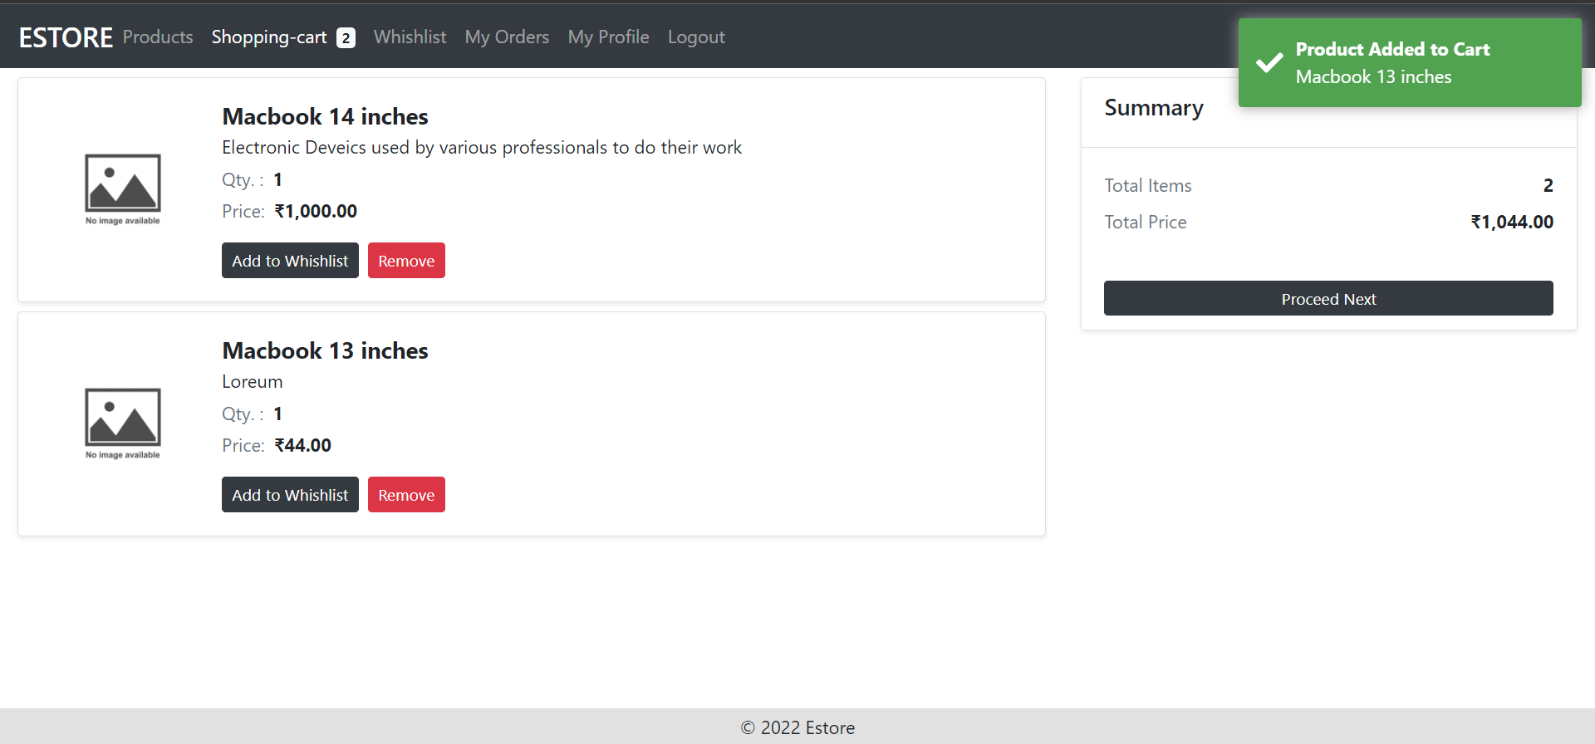
Shopping Cart Component: UI
The component displays the list of products added to the cart on the UI.
Notes:
The component displays the list of products added to the cart on the UI .

Slide 47
Shopping Cart Component: UI
Snippet for HTML template of the component:
<div *ngIf="cartProducts.length !== 0">
<div class="card shadow-sm mb-2" *ngFor="let product of cartProducts; index as idx">
<div class="card-body">
<div class="row w-100 m-0">
<div class="col-12 col-sm-2 d-flex justify-content-center align-items-center">
<img [src]="product['images'][product['thumbnailImage']] || './../../../assets/noImage.jpg'" [alt]="product['productTitle']" class="img-fluid" width="128px" height="128px"></div>
<div class="col-12 col-sm-10 mt-2 mt-sm-0">
<div class="d-flex flex-column">
<h5 class="m-0 font-weight-bold card-title mb-1">
{{ product["productTitle"] }}</h5>
<p class="card-text text-limit m-0 mb-1">
{{ product["productDescription"] }}</p>
<p class="card-text m-0 mb-1">
<span class="text-muted mr-2">Qty. :</span>
Notes:
Snippet for HTML template of the component:
<div *ngIf="cartProducts.length !== 0">
<div class="card shadow-sm mb-2" *ngFor="let product of cartProducts; index as idx">
<div class="card-body">
<div class="row w-100 m-0">
<div class="col-12 col-sm-2 d-flex justify-content-center align-items-center">
<img [src]="product['images'][product['thumbnailImage']] || './../../../assets/noImage.jpg'" [alt]="product['productTitle']" class="img-fluid" width="128px" height="128px">
</div>
<div class="col-12 col-sm-10 mt-2 mt-sm-0">
<div class="d-flex flex-column">
<h5 class="m-0 font-weight-bold card-title mb-1">
{{ product["productTitle"] }}
</h5>
<p class="card-text text-limit m-0 mb-1">
{{ product["productDescription"] }}
</p>
<p class="card-text m-0 mb-1">
<span class="text-muted mr-2">Qty. :</span>
<span class="font-weight-bold mr-2">{{ product["quantity"] }}</span>
</p>
<p class="card-text m-0 mb-3">
<span class="text-muted mr-2">Price:</span>
<span class="font-weight-bold">{{ product["price"] | currency:'INR':'symbol' }}</span>
</p>
</div>
<div class="d-flex align-items-center">
<button type="button" class="btn btn-sm btn-dark mr-2" (click)="db.moveProduct(product, true)">Add to Whishlist</button>
<button type="button" class="btn btn-sm btn-danger" (click)="removeItem(product['cartId'])">Remove</button>
</div>
</div>
</div>
</div>
</div>
</div>

Slide 48
Shopping Cart Component: UI
Snippet for HTML template of the component:
<span class="font-weight-bold mr-2">{{ product["quantity"] }}</span></p>
<p class="card-text m-0 mb-3">
<span class="text-muted mr-2">Price:</span>
<span class="font-weight-bold">{{ product["price"] | currency:'INR':'symbol' }}</span></p></div>
<div class="d-flex align-items-center">
<button type="button" class="btn btn-sm btn-dark mr-2" (click)="db.moveProduct(product, true)">Add to Whishlist</button>
<button type="button" class="btn btn-sm btn-danger" (click)="removeItem(product['cartId'])">Remove</button>
</div>
</div>
</div>
</div>
</div>
</div>
Notes:
Snippet for HTML template of the component:
<div *ngIf="cartProducts.length !== 0">
<div class="card shadow-sm mb-2" *ngFor="let product of cartProducts; index as idx">
<div class="card-body">
<div class="row w-100 m-0">
<div class="col-12 col-sm-2 d-flex justify-content-center align-items-center">
<img [src]="product['images'][product['thumbnailImage']] || './../../../assets/noImage.jpg'" [alt]="product['productTitle']" class="img-fluid" width="128px" height="128px">
</div>
<div class="col-12 col-sm-10 mt-2 mt-sm-0">
<div class="d-flex flex-column">
<h5 class="m-0 font-weight-bold card-title mb-1">
{{ product["productTitle"] }}
</h5>
<p class="card-text text-limit m-0 mb-1">
{{ product["productDescription"] }}
</p>
<p class="card-text m-0 mb-1">
<span class="text-muted mr-2">Qty. :</span>
<span class="font-weight-bold mr-2">{{ product["quantity"] }}</span>
</p>
<p class="card-text m-0 mb-3">
<span class="text-muted mr-2">Price:</span>
<span class="font-weight-bold">{{ product["price"] | currency:'INR':'symbol' }}</span>
</p>
</div>
<div class="d-flex align-items-center">
<button type="button" class="btn btn-sm btn-dark mr-2" (click)="db.moveProduct(product, true)">Add to Whishlist</button>
<button type="button" class="btn btn-sm btn-danger" (click)="removeItem(product['cartId'])">Remove</button>
</div>
</div>
</div>
</div>
</div>
</div>

Slide 49
Checkout Component: Place Order
1
The Checkout component uses the HTTP client request
to place an order for the user to the Java back-end service.
2
The order details will be saved in the database.
Notes:
Checkout Component shall use the Http Client Request to place an order for the User to Java back-end service.
The order details will be saved in the database.

Slide 50
Checkout Component: Place Order
The HTTP client request is used by the Checkout component to place an order for the user.
export class CheckoutComponent implements OnInit {
//…
this.httpClient.post(BaseUrls.getAddUrl(BaseUrls.ORDER_GROUPURL), formData)
.subscribe({
next: async ({ code, message, data }: any) => {
console.log(data);
let orderId = data[0]['orderId'];
let orderItems = this.cartProducts.map((e: any, idx: number) => {
this.db.removeItemFromList(e['cartId'], true, false);
return {
orderId: orderId,
productId: e.productId,
productTitle: e.productTitle,
productDescription: e.productDescription,
productCode: e.productCode,
productImg: e.images[e.thumbnailImage] || null,
productCategory: e.categoryId,
price: e.price,
quantity: e.quantity,
totalPrice: (e.price * e.quantity),
}});

Slide 51
Checkout Component: Place Order
The HTTP client request is used by the Checkout component to place an order for the user.
this.httpClient.post(`${BaseUrls.BASE_HREF}/${BaseUrls.ORDER_ITEMS_GROUPURL}/add-items`, orderItems)
.subscribe((value) => {
console.log(value);
this.toast.success("Order Placed Successfully");
});
},
error: (error) => {
console.log(error);
this.toast.warning("Something went wrong!!", "Failed")
}
})
}
}

Slide 52
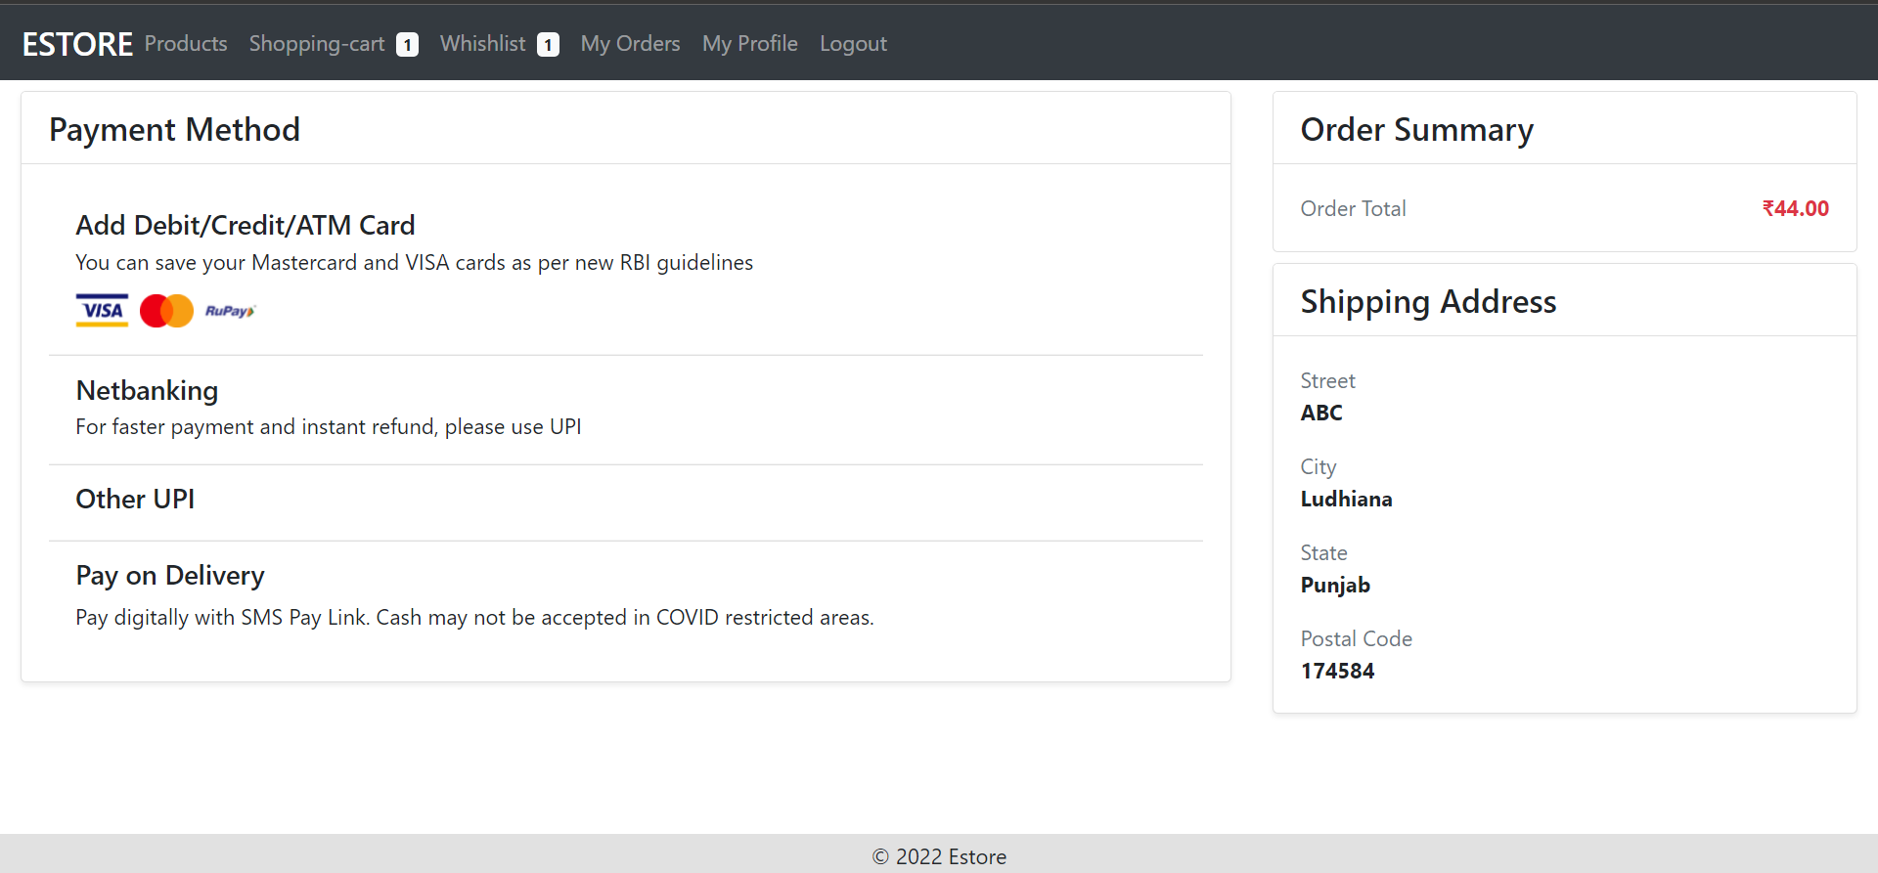
Checkout Component: UI
The Checkout component displays the order summary and shipping address details to place an order.
Notes:
The Checkout component displays the order summary and shipping address details to place an order.
Snippet for HTML template of the component:
<div class="card-body">
<p class="card-text d-flex justify-content-between text-danger">
<span class="text-muted text-sm">Order Total</span>
<span class="font-weight-bold">{{ totalPrice || 0 | currency:'INR':'symbol' }}</span>
</p>
</div>
</div>

Slide 53
Checkout Component: UI
Snippet for HTML template of the component:
<div class="card-body">
<p class="card-text d-flex justify-content-between text-danger">
<span class="text-muted text-sm">Order Total</span>
<span class="font-weight-bold">{{ totalPrice || 0 | currency:'INR':'symbol' }}</span>
</p>
</div>
</div>
Notes:
Snippet for HTML template of the component:

Slide 54
DB Service: getOrders
The DB Service getOrders method performs HTTP client requests to the order service endpoint in the Java back end to fetch all orders placed by the user. It also will contain methods to place an order for the user.
export class DbService { //…
constructor(
private httpClient: HttpClient
) { }
getOrders() {
if(!this.ordersRetreived) { this.http.get(`${BaseUrls.BASE_HREF}/${BaseUrls.ORDER_GROUPURL}/get-user-orders/${this.user?.userId}`)
.subscribe({
next: ({ code, message, data }: any) => {
this.orders.next(Object.assign([], data))
this.ordersRetreived = true
},
error: (error) => {
console.log(erro);} }) } }}
Notes:
The DB Service getOrders method performs HTTP client request to the order service endpoint in the Java back end to fetch all orders placed by user. It also will contain methods to place an order for the user.

Slide 55
Order Component: Methods
The Order component uses the getOrders method to display all the orders placed by users.
export class OrdersComponent implements OnInit {
orders: Orders[] = [];
constructor(
private db: DbService,
private httpClient: HttpClient
) { }
ngOnInit(): void {
this.db.getOrders();
this.db.orders.subscribe((list) => {
if(list.length !== 0) this.orders = list
})
}
}
Notes:
Order Component shall use the getOrders method to display all the orders placed by users.

Slide 56
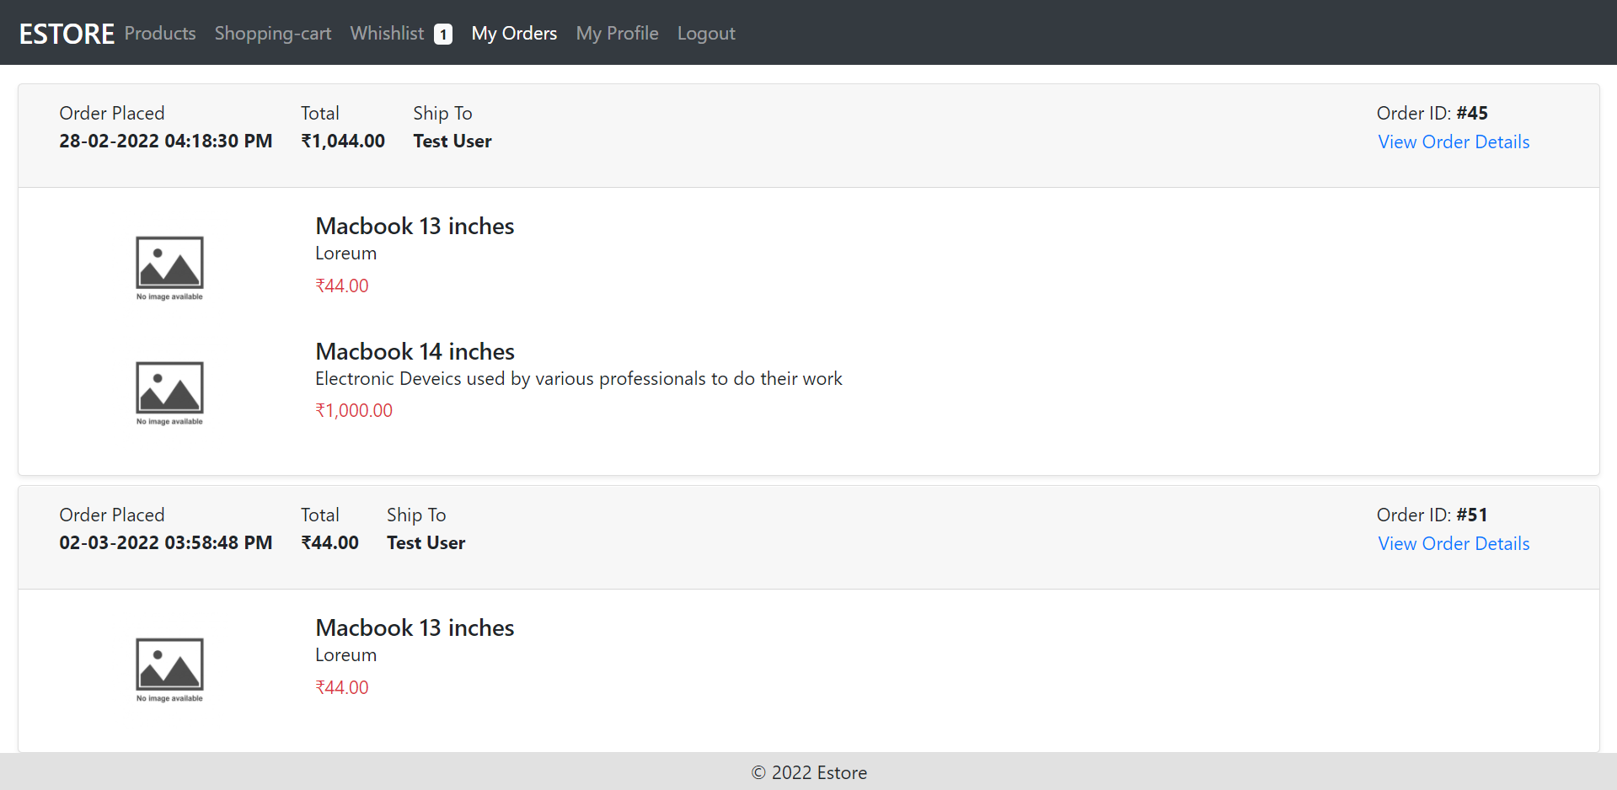
Order Component: UI
The component displays the list of orders placed by the user.
Notes:
Component displays the list of orders placed by the user.
Snippet for HTML template of the component:
<div class="d-flex">
<p class="card-text d-flex flex-column mr-4">
<span class="text-sm">Order Placed</span>
<span class="font-weight-bold">{{ order['orderDate'] | date: 'dd-MM-yyyy hh:mm:ss a' }}</span>
</p>
<p class="card-text d-flex flex-column mr-4">
<span class="text-sm">Total</span>
<span class="font-weight-bold">{{ order['totalAmount'] | currency:'INR':'symbol' }}</span>
</p>
<p class="card-text d-flex flex-column flex-grow-1">
<span class="text-sm">Ship To</span>
<span class="font-weight-bold">{{ order['name'] }}</span>
</p>
<p class="card-text d-flex flex-column mr-4">
<span class="text-sm">Order ID: <strong>#{{ order['orderId'] }}</strong></span>
<a type="button" class="btn btn-link p-0 text-left">View Order Details</a>
<!-- <span class="font-weight-bold">{{ order['totalAmount'] | currency:'INR':'symbol' }}</span> -->
</p>
</div>

Slide 57
Order Component: UI
Snippet for HTML template of the component:
<div class="d-flex">
<p class="card-text d-flex flex-column mr-4">
<span class="text-sm">Order Placed</span>
<span class="font-weight-bold">{{ order['orderDate'] | date: 'dd-MM-yyyy hh:mm:ss a' }}</span></p>
<p class="card-text d-flex flex-column mr-4">
<span class="text-sm">Total</span>
<span class="font-weight-bold">{{ order['totalAmount’] | currency:'INR':'symbol' }}</span></p>
<p class="card-text d-flex flex-column flex-grow-1">
<span class="text-sm">Ship To</span>
<span class="font-weight-bold">{{ order['name'] }}</span></p>
<p class="card-text d-flex flex-column mr-4">
<span class="text-sm">Order ID: <strong>#{{ order['orderId'] }}</strong></span>
<a type="button" class="btn btn-link p-0 text-left">View Order Details</a>
<!-- <span class="font-weight-bold">{{ order['totalAmount'] | currency:'INR':'symbol' }}</span> --></p></div>
Notes:
Snippet for HTML template of the component:
<div class="d-flex">
<p class="card-text d-flex flex-column mr-4">
<span class="text-sm">Order Placed</span>
<span class="font-weight-bold">{{ order['orderDate'] | date: 'dd-MM-yyyy hh:mm:ss a' }}</span>
</p>
<p class="card-text d-flex flex-column mr-4">
<span class="text-sm">Total</span>
<span class="font-weight-bold">{{ order['totalAmount'] | currency:'INR':'symbol' }}</span>
</p>
<p class="card-text d-flex flex-column flex-grow-1">
<span class="text-sm">Ship To</span>
<span class="font-weight-bold">{{ order['name'] }}</span>
</p>
<p class="card-text d-flex flex-column mr-4">
<span class="text-sm">Order ID: <strong>#{{ order['orderId'] }}</strong></span>
<a type="button" class="btn btn-link p-0 text-left">View Order Details</a>
<!-- <span class="font-weight-bold">{{ order['totalAmount'] | currency:'INR':'symbol' }}</span> -->
</p>
</div>

Slide 58
Run the Project as Spring Boot App
To make the Angular app interact with the Java back-end services, the project needs to be running.
Right-click on the project and run it as the Spring Boot app
or
Click the run icon and select run as the Spring Boot app
Notes:
In order to make your Angular app interact with the Java back end services, you need your project to be running.
Right click on the project and run as Spring Boot app.
Or
Simply click the run icon and select run as spring boot app.

Slide 59
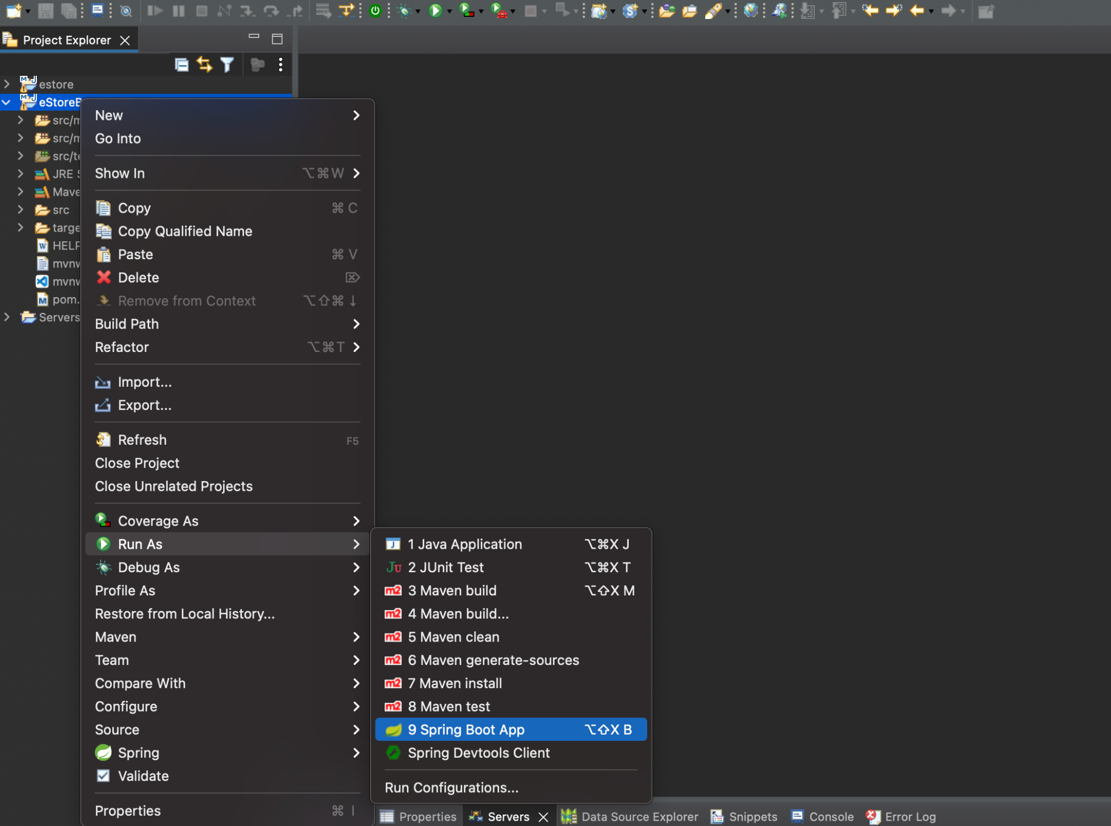
Run the Project as Spring Boot App
Start the project as a Spring Boot application.

Slide 60
Project Run Output Logs
1
Check in the console if the application is running successfully on Tomcat port 8080
2
In case 8080 port is blocked, go to application.properties file and change the server port number
3
Once the back end is up and running, serve the Angular app and test the communication
Notes:
Check in the console if the application is running successfully on Tomcat Port 8080.
In case 8080 port is blocked, go to application.properties file and change the server port number.
Once the back end is up and running, you can serve your Angular app and test the communication.

Slide 61
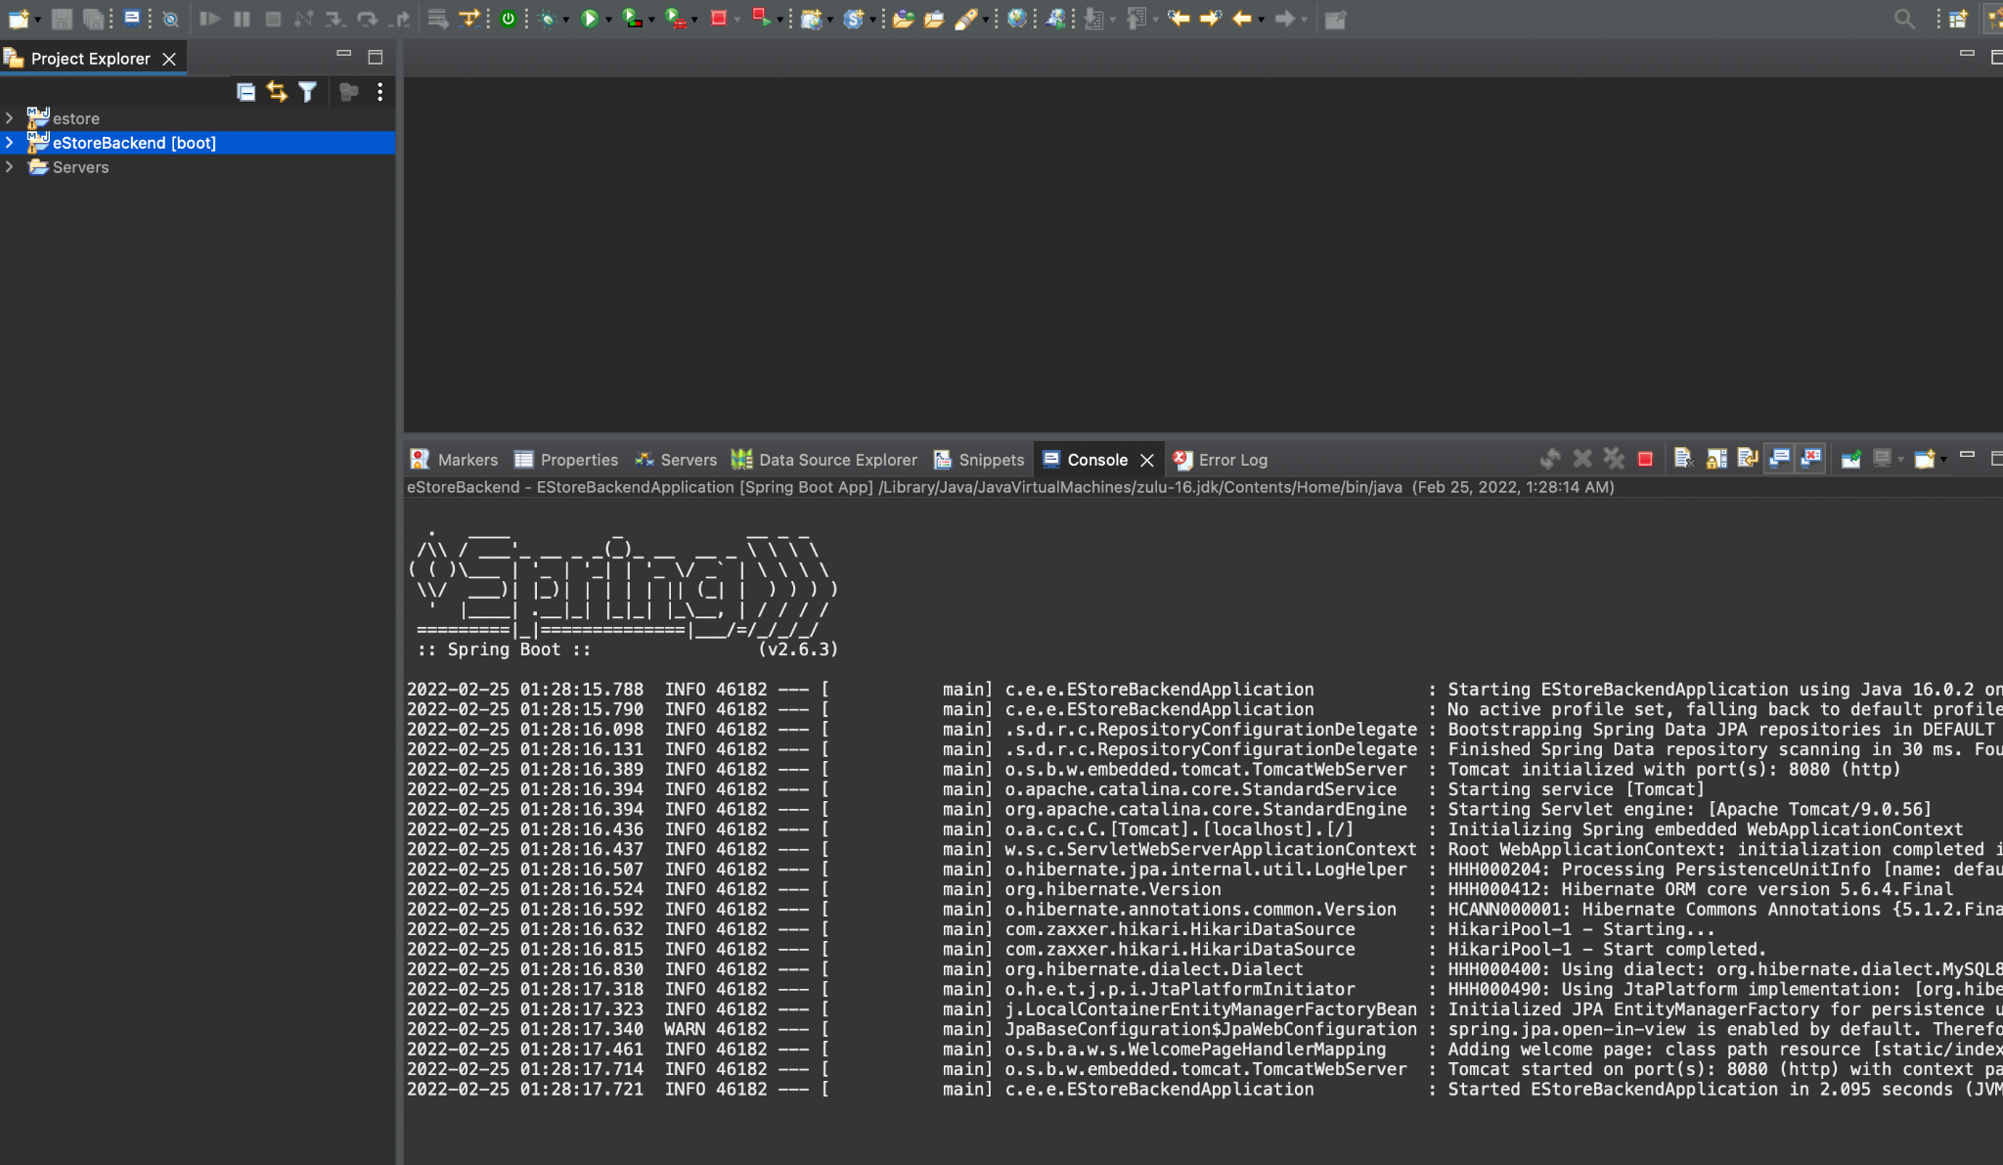
Project Run Output Logs
Output Logs from Projects

Slide 62
Implement the HttpClient API in Angular to perform request-response over HTTP to various back-end services.
Angular components are used to send the HTTP client request to Java back-end services.
HTML templates are used to render the data fetched from the Java back-end service.

Slide 64
What is the role of Observables?
01
They help to manage data synchronously
They help to manage data asynchronously
They help to manage data synchronously or asynchronously
None of above

Slide 65
What is the role of Observables?
01
They help to manage data synchronously
They help to manage data asynchronously
They help to manage data synchronously or asynchronously
None of above
B
Observables help in managing data in an asynchronous way.

Slide 66
How will users display the list of products in the HTML template?
02
using ngFor
using ngIf
using ngModel
using ngClass

Slide 67
How will users display the list of products in the HTML template?
02
using ngFor
using ngIf
using ngModel
using ngClass
A
Users can use ngFor to display the list of products in the HTML template. For example, <div *ngFor="let product of products">

Slide 68
What is the default response type in http client request in Angular?
03
json
text
arraybuffer
blob

Slide 69
What is the default response type in http client request in Angular?
03
json
text
arraybuffer
blob
A
The default response type is json, but you can change it. For example, this.http.post( 'http://localhost:8080/login', {email, password}, {responseType: 'text'})

Slide 70
How can users catch errors for HTTP requests?
04
this.httpClient .get("url") .catch((err: HttpErrorResponse) => { });
this.httpClient .get("data-url").subscribe( data => console.log('success', data), error => console.log('oops', error) );
Both
None

Slide 71
How can users catch errors for HTTP requests?
04
this.httpClient .get("url") .catch((err: HttpErrorResponse) => { });
this.httpClient .get("data-url").subscribe( data => console.log('success', data), error => console.log('oops', error) );
Both
None
B
Users can catch the error by either using the catch clause or the error handler in subscribe.

Slide 72
Which API represents serialized parameters for HTTP requests or response bodies?
05
HttpClient
HttpModule
HttpParams
HttpContext

Slide 73
Which API represents serialized parameters for HTTP requests or response bodies?
05
HttpClient
HttpModule
HttpParams
HttpContext
C
Users can use HttpParams to provide parameters. For example, new HttpParams({ fromObject: { param1: 'value1', param2: 'value2', } });

Slide 74
Before the Next Class
You have successfully completed this session. Before the next discussion you should go through:
Docker
Jenkins
AWS

Slide 75
What’s Next?
Now, we have finished our classes and design pattern for the back-end project with respect to the end-user module. In our next live session, we will:
Build projects on Jenkins
See how to dockerize the apps and run them in containers
Explore various docker commands
Create a Jenkins file which defines the Pipeline for CI/CD flow

